Slide 1
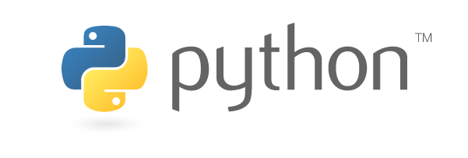
Python Programming

Slide 2
Few buzz words
general-purpose programming language
High Level
Interpreted at run time, no compilation is required
Interactive
Object oriented
Highly readable, close to English language
Great for beginners, do everything you want
Created during 1985-90, by Guido Van Rossum
Available under GNU General Public License (GPL)

Slide 3
Variable types
Operators
Decision making
Loops
String
List
Tuple
Dictionary
https://www.youtube.com/watch?v=N4mEzFDjqtA

Slide 4
Functions & Exceptions
http://tutorialspoint.com/python/

Slide 5
File IO

Slide 6
Database IO

Slide 7
Object Oriented
Encapsulation
Inheritance
Polymorphism

Slide 8
Anaconda
Anaconda is a scientific/data analysis distribution for Python and a bunch of popular data modules
Either this or plain python vanilla with pip install <packages>

Slide 9
Data visualization- Matplotlib
http://matplotlib.org/users/pyplot_tutorial.html
matplotlib is a plotting library for the Python programming language and its numerical mathematics extension NumPy. It provides an object-oriented API for embedding plots into applications using general-purpose GUI toolkits like wxPython, Qt, or GTK+.
https://pythonprogramming.net/matplotlib-intro-tutorial/

Slide 10
Scientific computations- numpy
https://www.youtube.com/watch?v=u_08lOcwV-A
NumPy (pronounced "Numb Pie" or sometimes "Numb pee"^{[1][2]}) is an extension to the Python programming language, adding support for large, multi-dimensional arrays and matrices, along with a large library of high-level mathematical functions to operate on these arrays.

Slide 11
Data Analysis & Manipulation- Pandas
https://www.youtube.com/watch?v=Iqjy9UqKKuo
Pandas is a software library written for the Python programming language for data manipulation and analysis. In particular, it offers data structures and operations for manipulating numerical tables andtime series.
Data source: https://www.quandl.com/
https://pythonprogramming.net/data-analysis-python-pandas-tutorial-introduction/

